Slide 1
Practice Session 2 Story of Stuff

Slide 2
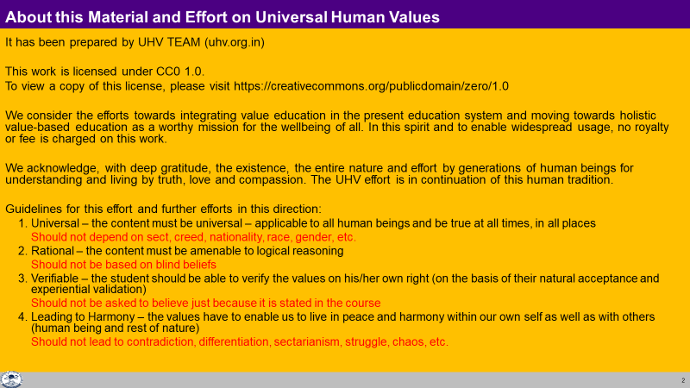

Slide 3
Story of Stuff
Watch a 20 minute video "Story of Stuff"
It is a documentary about the materials economy – its motivation, process and outcome. It has been produced by a set of concerned people at storyofstuff.org, USA
(source: http://storyofstuff.org/movies/story-of-stuff/)
We will discuss your observations:
What are the activities and efforts made by the people shown in the video? Reflect on your own activities and efforts. Are they similar to those of the people shown in the video?
How are their activities motivated by their notion of happiness (physical facility = happiness. More shopping, physical facility = more happiness)? Is this and any other notions of happiness their own notions or they are programmed by advertisements, others? Is this notion true or is it getting the people more and more into the loop of more and more physical facility only?
Reflect on your own notion of happiness – is it your own notion or is it borrowed from others?
(this is important – after all, you are making all the effort for being happy)

Slide 4
Discussion

Slide 5
Our Program depends on our Notion of Happiness
If we assume that consumption is happiness, then we consume
Tasty food → happiness
Latest mobile → show off → happiness
If we assume happiness will come from abstinence, we abstain
Torn clothes → happiness
Bunking classes → happiness
Like that, whatever our assumption or understanding about happiness is, we make a program accordingly
It is a matter of understanding happiness!
(it is not a matter of just focusing on the program or do’s and don’ts)
We will explore into it…

Slide 6
Problem (as shown in video) Solution (as shown in video)
Production of unhealthy products with focus on profit vs purpose (eg. carcinogenic pillows)
Exploitation of the people involved in production, consumption
Over exploitation of natural resources
Linear production process
Indulgence (influenced by media & marketing)
99% waste
??
??
??
Cyclic production process
??
Recycling can help (but it will never be enough)
Can we have a holistic solution
without Right Understanding?
(including understanding of happiness)
Symptoms of assuming Happiness = Consumption

Slide 7
Can discuss “Prevailing Notions of Happiness” in this session
It is important to return to exploring the holistic solution (return to the topics discussed before this practice session), rather than only detailing out the problem
Later, we will explore into a potential goal of all human beings living together (human goal) and how it can be fulfilled with right understanding at the base

